Slide 1
Zenmark Properties
An Insight into Zidio Development Company and Web Development Basics

Slide 2

Introduction
This presentation explores Zidio Development Company and covers the basics of web development including HTML, CSS, and JavaScript.

Slide 3
01
Zidio Development

Slide 4

Company Overview
Zidio Development is a leading company in wesite development, focused on innovative solutions and sustainable practices. It has successfully executed numerous projects, showcasing expertise in design, development, and client satisfaction.

Slide 5

Mission and Vision
The mission of Zidio Development is to deliver high-quality web projects that enhance communities and provide long-term value. The vision focuses on being a market leader by leveraging technology and sustainable practices to create spaces where people can thrive.

Slide 6
02
Web Development

Slide 7
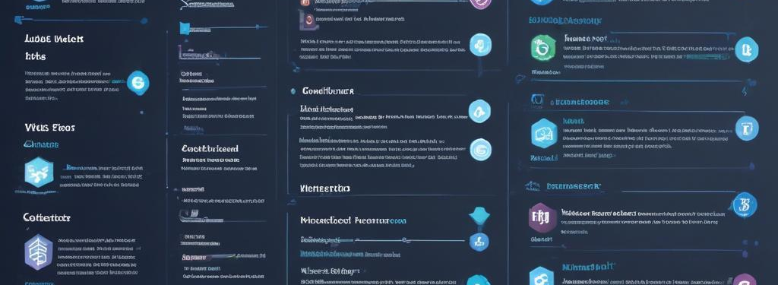
Introduction to HTML
HTML, or HyperText Markup Language, is the standard markup language used to create web pages. It defines the structure of a webpage using various elements like headings, paragraphs, links, images, and more. HTML elements are represented by tags, which guide the browser on how to display the content. Understanding HTML is foundational for any web developer, as it forms the backbone of any web application.

Slide 8
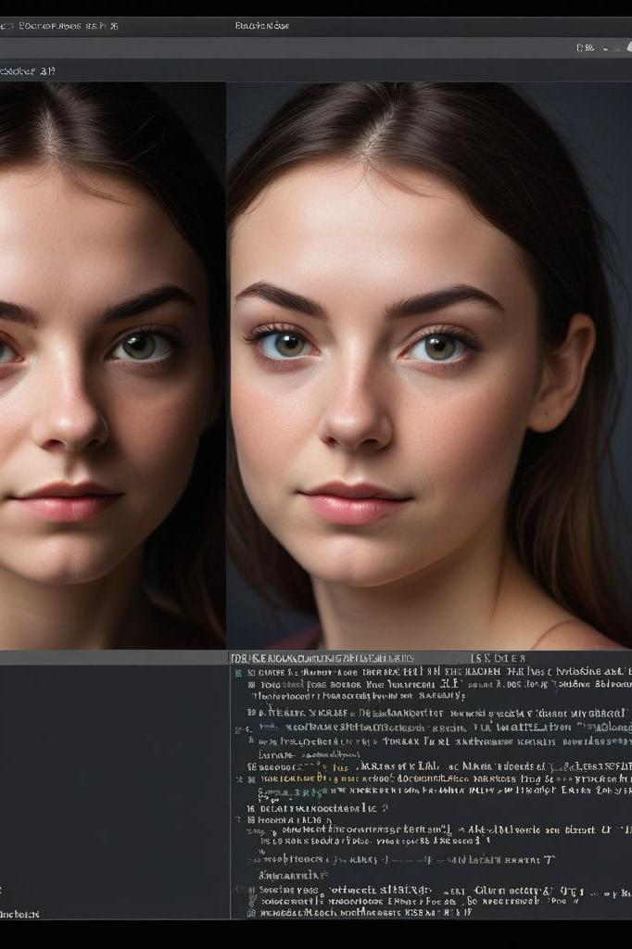
Introduction to CSS
CSS, or Cascading Style Sheets, is a stylesheet language used to describe the presentation of a document written in HTML. CSS controls the layout, colors, fonts, and overall visual aesthetics of a website. By separating content (HTML) from design (CSS), developers can create visually appealing and responsive web pages that enhance user experience. With CSS, developers can apply styles to multiple pages at once for consistency.

Slide 9

Introduction to JavaScript
JavaScript is a dynamic programming language that enables interactive web applications. It runs in the browser and allows for the implementation of complex features such as animated graphics, form validations, and interactive maps. JavaScript enhances user experience by enabling functionalities like event handling and real-time updates, making it a critical component for modern web development alongside HTML and CSS.

Slide 10

Conclusions
Understanding the foundational elements of web development—HTML, CSS, and JavaScript—is crucial for creating effective and engaging websites. Zidio Development exemplifies the importance of innovative design and sustainable practices in real estate. By mastering these web technologies, developers can create user-friendly and aesthetically pleasing websites that serve various business needs.

